Slide 1


Slide 2
MAVEN
Maven is a powerful build automation & dependency management tool used in mainly Java Base project. It is used for projects build, dependency and documentation.
Apache Maven is a software project management and comprehension tool. Based on the concept of a project object model (POM), Maven can manage a project's build, reporting and documentation from a central piece of information. Using maven, we can build and manage any Java based project.
Maven is a build automation and project management tool used mainly for Java projects. It helps developers build, manage, and document software projects easily.

Slide 3
Understanding the problem without Maven
There are many problems that we face during the project development. They are discussed below:
1) Adding set of Jars in each project: In case of struts, spring, hibernate frameworks, we need to add set of jar files in each project. It must include all the dependencies of jars also.
2) Creating the right project structure: We must create the right project structure in servlet, struts etc, otherwise it will not be executed.
3) Building and Deploying the project: We must have to build and deploy the project so that it may work.

Slide 4
What it does?
It makes a project easy to build.
Centralized the Dependency Management.
It provides project information (log document, cross referenced sources, mailing list, dependency list, unit test reports etc.)
It is easy to migrate for new features of Maven.
4. Integration with IDEs (Eclipse, IntelliJ, etc.)
5. Works well with CI/CD tools like Jenkins.

Slide 5
Maven pom.xml file
POM is an acronym for Project Object Model. It is core configuration file in Maven Project. The pom.xml file contains information of project and configuration information for the maven to build the project such as dependencies, build directory, source directory, test source directory, plugin, goals etc.
Maven reads the pom.xml file, then executes the goal.

Slide 6
Element | Description
project | It is the root element of pom.xml file.
modelVersion | It is the sub element of project. It specifies the modelVersion. It should be set to 4.0.0.
groupId | It is the sub element of project. It specifies the id for the project group(package).
artifactId | It is the sub element of project. It specifies the id for the artifact (project). An artifact is something that is either produced or used by a project. Examples of artifacts produced by Maven for a project include: JARs, source and binary distributions, and WARs.
version | It is the sub element of project. It specifies the version of the artifact under given group.

Slide 7
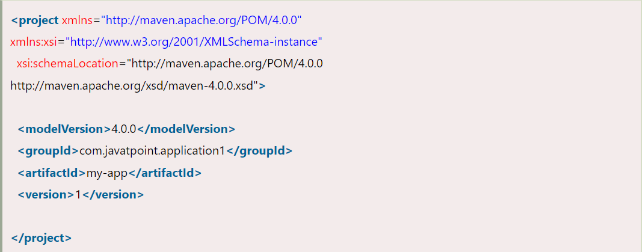

Slide 8
Maven pom.xml file with additional elements
Element | Description
packaging | defines packaging type such as jar, war etc.
name | defines name of the maven project.
url | defines url of the project.
dependencies | defines dependencies for this project.
dependency | defines a dependency. It is used inside dependencies.
scope | defines scope for this maven project. It can be compile, provided, runtime, test and system.

Slide 9
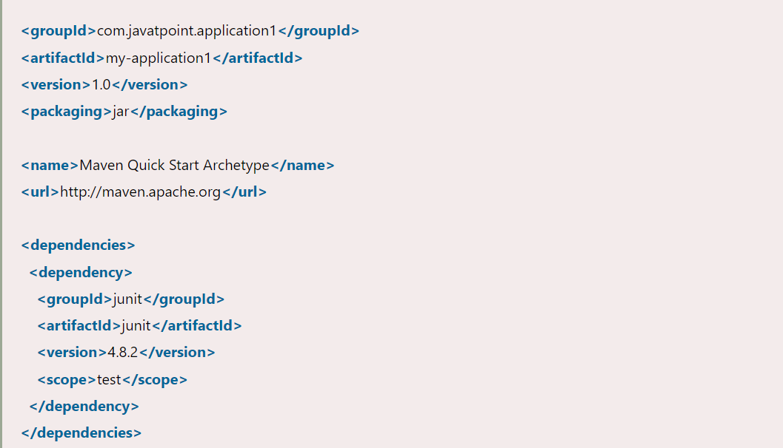

Slide 10
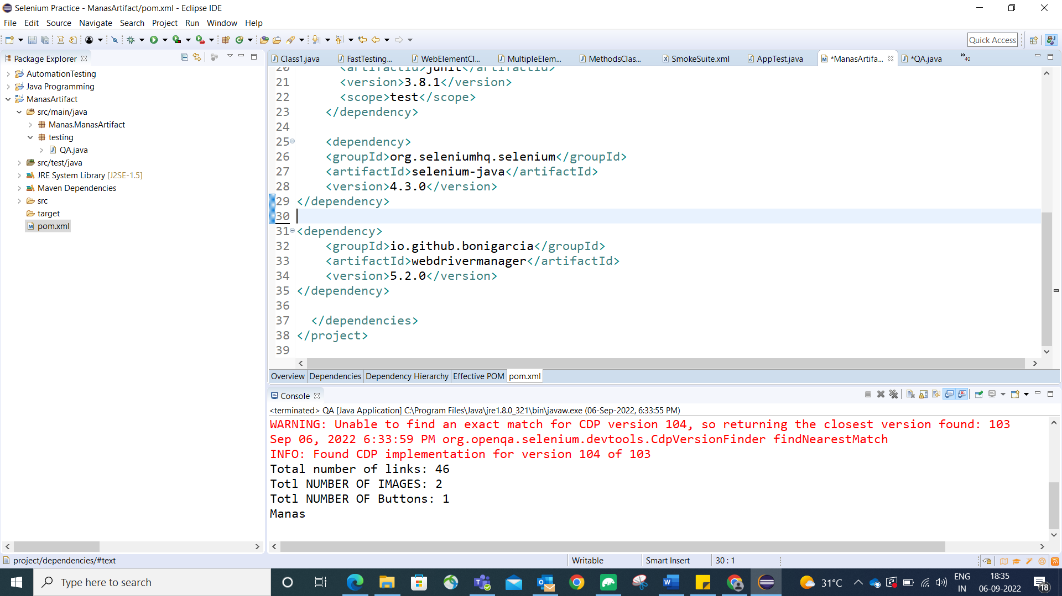

Slide 11
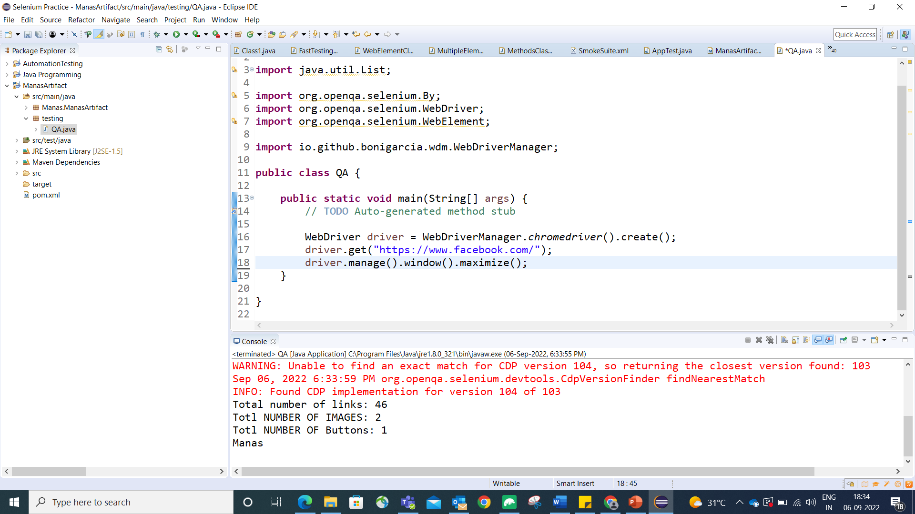

Slide 12
